Slide 1
COVID-19 and schools:
Data & Evidence
Emily Oster
Professor of Economics
Brown University

Slide 2
Setting The Stage: Timeline
March 2020: Nearly all schools in the US and Europe closed for in-person learning
  Exception: Sweden
Late Spring/Summer, 2020: Some schools in Europe, UK reopened
August/September, 2020: Some US schools reopened (Georgia, Indiana, Florida, etc)
Fall 2020: School openings ebb & flow
Winter 2021: Push for more opening continues.
2021-2022: Uncertain.

Slide 3
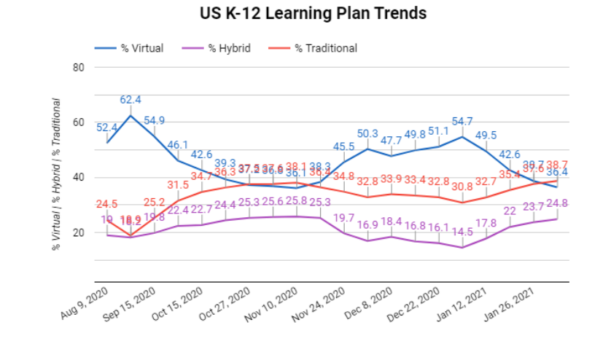
Burbio Opening Data

Slide 4
European Data
UK, Germany, Spain
Generally very reassuring
But…low rates in Europe, totally different infrastructure
Main concern was this wasn’t relevant to the US.

Slide 5
Motivation for Data Collection in US
August: Schools opening in Georgia, Indiana, elsewhere
  European data encouraging but unclear how relevant.
Three key questions:
  Are Schools “Super-spreaders?”
  What mitigation factors matter?
  What type of spread occurs in school? Between whom?
August reopening: No centralized data collection planned, either at Federal or most State level.

Slide 6
COVID-19 School Response Dashboard
Joint effort between School Superintendents Association, two principal associations, Qualtrics, team from Brown
Key data: opening details (# in-person students, staff), mitigation, ongoing tracking of COVID cases.
Data Approach:
  Initial: opt-in by schools & districts
  Current: opt-in + several states with consistent data.
  Ongoing: attempts to add new states.
Biweekly data collection, “fast” posting.

Slide 7
Dashboard Data & Results

Slide 8
Dashboard Data & Results

Slide 9
State Data

Slide 10
By Race

Slide 11
Case Distributions

Slide 12
Mitigation

Slide 13
Comparison Rates

Slide 14
Limitations
Opt-in data (some of it)
No contact tracing or details about in-school transmission
What is the right comparison rate?
Mitigation details
  3 versus 6 feet
  Density?
  Types of ventilation
Geographic diversity, other demographic diversity

Slide 15
New Data
North Carolina
  90,000 people, 9 weeks
  ~773 community-acquired infections, 32 school-acquired infections
  No student to staff transmission
Wisconsin
  ~5500 students + staff
  191 cases, 7 in-school transmission
Wrestling tournament problematic.
What’s missing?
  Detailed Guidance, more data, more tracking.

